Slide 1
What Can the Cloud Do For Me?
<Name> | <Title>
<Contact Info>

Slide 2



Companies of all sizes are placing big bets on cloud.

Slide 3

When you graduate your job will probably use cloud.

Slide 4

If you want your choice of jobs, shouldn’t you be prepared?

Slide 5

You can start using the cloud
O
A
T
D
Y

Slide 6

Let’s dig in and see how!

Slide 7

What is the Cloud?

Slide 8
Why the cloud?
Speed
Scale
Economics
Notes:
Rapidly setup environments to drive business priorities
Scale to meet peak demands
Increase daily activities, efficiency and reduced cost.

Slide 9

For example: How many servers would you need to host the website for the Olympics?

Slide 10
How do we manage applications that have spikes in demand?
You could buy enough servers to handle the peaks
You can run it in the cloud. When you hit a spike, spin up extra resources, when the spike ends shut down the extra resources

Slide 11
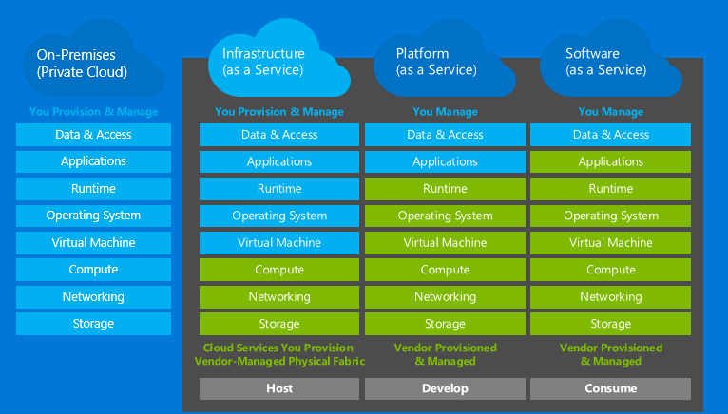
The Cloud Models

Slide 12






Need lots of different configurations for development and testing?

Slide 13





How do you handle all the versions and configurations?
You could set up VMs or install everything on your servers and laptops
You can install VMs in the cloud, and remove them when they are no longer needed
2013
2015

Slide 14
Azure Virtual Machines
→ Launch Windows Server and Linux in minutes
→ Scale from 1 to 1000s of VM Instances
→ Save money with per-minute billing
→ Open and extensible
Notes:
Slide Objectives:
High-level selling points of virtual machines.
Speaker Notes:
Both Linux and Windows are supported. It’s important to reiterate on this as many developers are still not aware of this.
Mention scaling at enterprise level using DSC, Puppet or Chef.
Emphasize on the openness – we are not forcing your to lock on Microsoft technologies. Instead, Azure is more open than ever. You can leverage your existing skills, tools and services, and Azure is providing more and more first-class supports for them.

Slide 15


Provisioning VM
Getting Started
Select Image and VM Size
New Disk Persisted in Storage
Windows Server
Management Portal
Boot VM from New Disk
Linux
>_
General Purpose
Basic
Standard
Optimized Compute
Performance Optimized
Network Optimized
Scripting
(Windows, Linux and Mac)
Cloud
REST API
Notes:
Slide Objective:
Explain workflow for provisioning VMs in the cloud
Speaker Notes:
You have three methods of starting this process: Build a VM from the portal, from the command line OR programmatically calling the REST API.
Once your choice of provisioning is made you will need to select the image and instance size to start from.
The newly created disk will be stored in blob storage and your machine will boot.

Slide 16

















VM Gallery
A collection of prebuilt images for various workloads
Windows Server 2012 R2
Ubuntu Server 14.04 LTS
CentOS 6.5
SUSE Linux
Enterprise Server
openSUSE 13.1
Oracle Linux 6.4.0.0.0
SQL Server 2014 Standard
Oracle Database 11g R2
SharePoint Server Farm
Microsoft Dynamics
GP 2013
Zulu 8
BizTalk Server 2013
SAP HANA
Developer Edition
Puppet Enterprise 3.2.3
Barracuda Web Application
Oracle WebLogic
Server 12.1.2
Visual Studio Ultimate 2013
Windows 8.1 Enterprise
Microsoft Azure
Notes:
Slide Objective:
Explain a wide variety of images that you can choose from.
Speaker Notes:
First of all, you can choose from different Windows Servers and a variety of Linux implementations. [Click]
As well as pre-built images for different flavors of SQL Database and Oracle databases. [Click]
You can also choose from a number of first-party and certified third-party images for various application servers and infrastructural components. [Click]
And last but not least, if you are a MSDN subscriber, you also have access to Visual Studio images and client Windows systems such as Windows 7 and Windows 8.1 for your DevTest purposes.

Slide 17
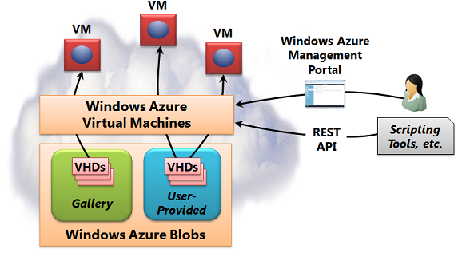
Microsoft Azure can host virtual machines in the cloud
Create the VM from the portal or with the Azure Service Management APIs
Select a Virtual Hard disk for the VM's image from the gallery or upload your own
Select the size of your VM
Pick an Azure Datacenter to host your VM

Slide 18
Demo: Create a Virtual Machine on Azure
Try it

Slide 19






VM Extensions
Installable components to customize VM instances
Enable various DevOps scenarios
Can be added, updated, disabled or removed at any time
Managed via portal, PowerShell and Management APIs
Microsoft Azure
Notes:
Slide Objective:
Introduce VM extensions.
Speaker Notes:
No matter how big the image gallery is, your projects may have specific needs that can’t be satisfied by standard images.
Some components such as anti-virus, configuration management agents are required on most machines for compliance and management purposes.
This allows use to innovate faster to meet with your project needs. And you have flexibility to pick and combine extensions for your goals.
Point out some of existing extensions:
Custom Script Extension, which allows you to download and execute PowerShell scripts.
Chef Extension and Puppet Extension for automated management at scale.
Symantec Endpoint Protection etc. for protection.
Docker (Linux only).
Visual Studio Remote Debugger.

Slide 20

Tips to save money if you use virtual machines
VMs are billed on a per minute basis
Stop the VM when you aren't using it to reduce billing costs (you will still be charged for the storage but that is much cheaper than the VM)
All the details are here:
http://azure.microsoft.com/en-us/pricing/details/virtual-machines/

Slide 21
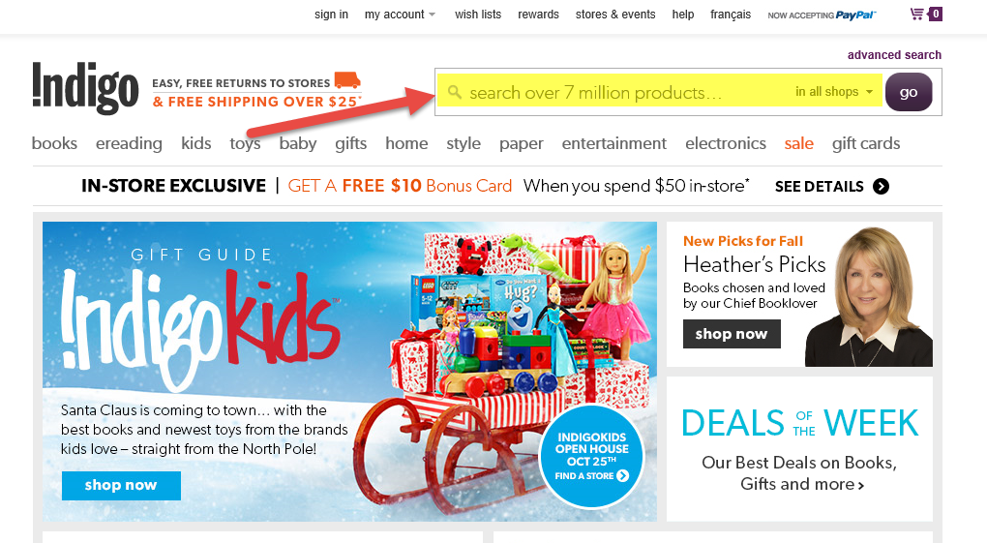
How many websites need search?

Slide 22
Searches should be fast and user friendly
Data should be split into Categories/facets
e.g. Hardcover/Paperback/Ebook/DVD
Users like Type-ahead suggestions
e.g. Albuq –> Albuquerque
You can suggest queries based on near matches/synonyms
e.g. sneakers -> running shoes
You need the ability to split search results across pages
The more data you have the more indexes you want to keep queries fast and the more storage and CPU power you need!

Slide 23

You can code the functionality yourself…

Slide 24
Or use a cloud service like Azure Search
Use REST APIs to upload, process, and query the data
Use REST APIs to create indexes
All the indexed data must be persisted within Azure search
There’s a good video introduction here: http://channel9.msdn.com/Shows/Data-Exposed/Introduction-To-Azure-Search
Azure Search is currently in preview, and there is a free preview trial offer

Slide 25
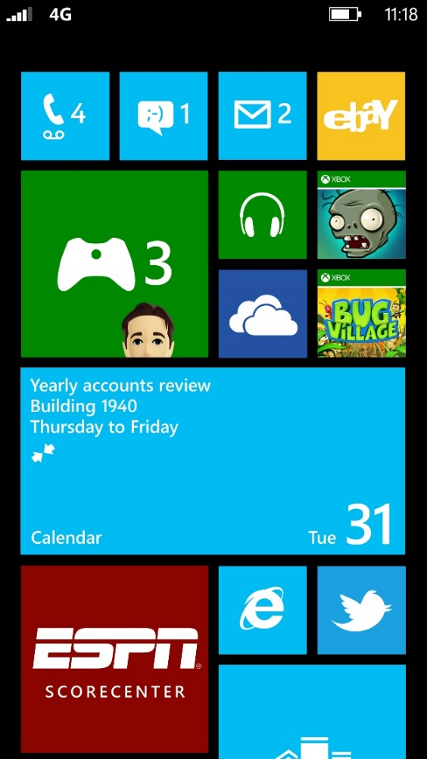
It’s a mobile world!

Slide 26
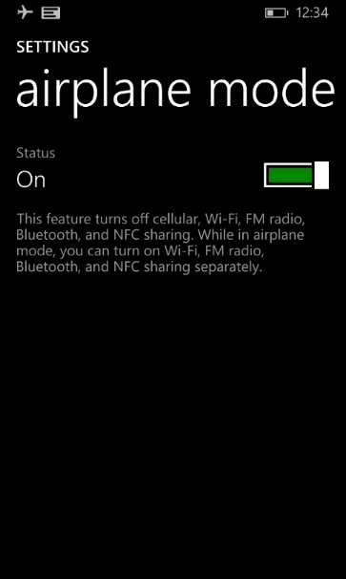
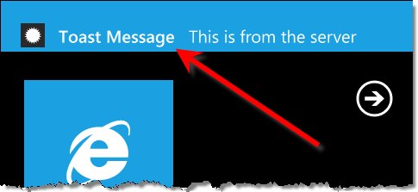
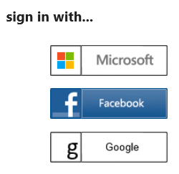

There are many features you want when you build mobile apps:
Notifications
The ability to
Use an app
offline
User Login & Authentication
The ability to share data between users

Slide 27




More platforms = more users, but does more platforms = more code?

Slide 28
Azure Mobile Services allows you to add functionality from the cloud
Let users sign into your app with their Facebook, Twitter, Active Directory or Google account
Push notifications to notify users of important information
Cloud based sync so users can use your app offline
The more you do in the cloud the less you have to recode for different platforms

Slide 29
Demo: How to Use Azure Mobile Services
Try it

Slide 30
What does your data look like?

Slide 31
Do you work with relational data?
Departments
DeptId | Name | Region | BudgetCode
1 | Finance | East | 30100
2 | HR | East | 40100
3 | IT | West | 30200
Azure SQL Database allows you to have tables with keys, relationships, and indexes
Employees
EmpId | FirstName | LastName | Salary | DeptId
1 | Bill | Gates | 100000 | 3
2 | Satya | Nadella | 100000 | 3
3 | John | Doe | 60000 | 2

Slide 32
Do you store simple key value pairs?
Key Name | Key Value
High Score | 10320
Azure supports Redis/Cache or Table Storage
Key Name | Key Value
Top Player | John Doe
Key Name | Key Value
Nbr Visitors | 67770

Slide 33
Are you a NoSQL fan?
For schema free document storage consider Azure DocumentDB a NoSQL Document database
Azure DocumentDB supports JSON and JavaScript, SQL & LINQ
You can develop Node.js, Python, ASP.NET or Java applications with DocumentDB
You can also use Mongo as a Service on Azure
item | Qty | Type
Pen | 230 | Blue
Pen | 410 | Red
Envelope | 25 | Legal
Envelope | 50 | Letter

Slide 34


Are you working with Images, Audio & Video?
Media Services allows on demand or live streaming delivery
Azure Storage stores BLOBS

Slide 35

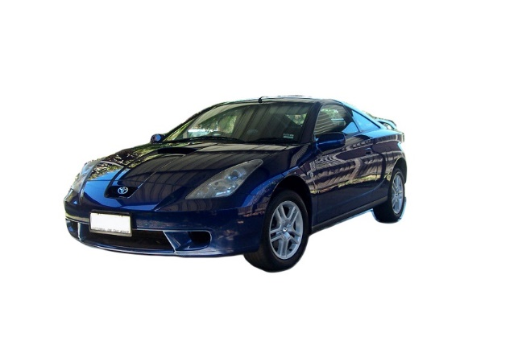
How much should a 19 year old pay for car insurance?

Slide 36
That depends on how likely they are to get into an accident?

Slide 37

Want to predict the future?

Slide 38
Check out predictive analytics and machine learning
We have lots and lots of data out there
Mining that data can provide you with a lot of powerful information
It takes a lot of storage and a lot of CPU
Azure Machine Learning has built in algorithms so you don’t have to be a data scientist to start looking for trends in your data

Slide 39

If you are a data scientist…
Arrrrrr!
Good for you! Your skills are in demand!
Azure Machine Learning also supports R, the open-source programming environment for statistics and data mining

Slide 40

Where do you host websites?

Slide 41
If it’s not on your own server, it’s in the cloud!
Website hosting is one of the most common ways people use the cloud

Slide 42

Develop apps with…
.NET
Python
Node.js
Java
PHP

Slide 43

Choose your own Adventure for deployment!
Visual Studio
Online
CodePlex
Git
GitHub
BitBucket
DropBox
FTP

Slide 44
Need more power?

Slide 45
You can scale up and down in seconds with no code changes*
Instance Count
1
6
Instances
*You need the BASIC web hosting plan to support manual scaling, this is not available with the FREE web hosting plan

Slide 46
Doing it manually isn't always practical.

Slide 47
AutoScale

Slide 48
AutoScale

Slide 49
AutoScale

Slide 50
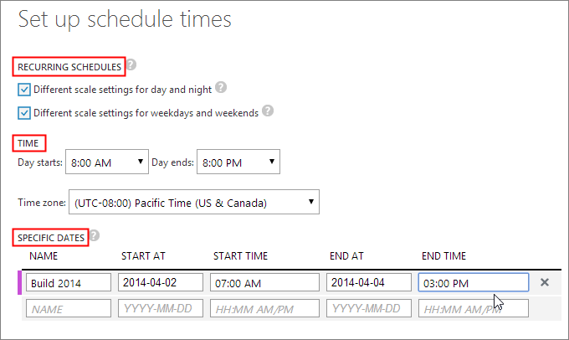
Set up a schedule
Specify dates and times when you need additional capacity

Slide 51
Scale by Metric
Specify min and max instances to use
Instance Count
2
6
Instances
Specify min and max and CPU for your site, and Azure will spin up or shut down instances to reach that target
Checks every 5 minutes to see if more instances needed
If CPU usage low than removes instances once/two hours
[Metric]
60
80
Percent

Slide 52
How do I deploy a new website safely?

Slide 53
Staging

Slide 54
Staging

Slide 55
Staging

Slide 56
Staging

Slide 57
Advantages to staging*
You can test your site before you put it in production
When you go live, the original production site is moved to the staging slot so if there is a problem you can quickly switch back
Your instances are warmed up in staging so you when you go to production you don't have downtime
Traffic redirection is seamless
*requires the STANDARD web hosting plan

Slide 58
Expecting customers from around the world?

Slide 59
14 regions worldwide in 2014
Azure
Websites footprint

Slide 60
Intelligent customer routing with Traffic Manager
www.yourapp.com

Slide 61
Customers are automatically routed to the site with lowest latency
www.yourapp.com

Slide 62
Demo: Create A Website and Push It To the Cloud

Slide 63

Do I have to pay for all this?

Slide 64
Who can get free Azure?

Slide 65
There are some free Azure offers:
If you are teaching a class, you can get 120 day Azure passes (no credit cards required) for you and all your students
www.microsoftazurepass.com
If you are doing research, you can apply for an Azure Research grant to get some serious Azure power!
www.azure4research.com
If you are starting up a business, you can apply to BizSpark to get free MSDN that includes monthly Azure credits
www.bizspark.com
Anyone can get a free 30 day trial (credit card is required but you set the option that determines if it can charge your card when you hit your limit, or just disable when you hit your limit)
www.azure.Microsoft.com

Slide 66
Free vs. paid Azure websites…
You can get up to 10 websites for free (bandwidth and storage are capped for free websites, you can get all the details on free vs paid Azure websites here:
http://azure.microsoft.com/en-us/pricing/details/websites/

Slide 67
How do I know how much the Azure service I want to try will cost?

Slide 68
There is a price calculator
http://azure.microsoft.com/en-us/pricing/calculator/

Slide 69
So now what…?

Slide 70
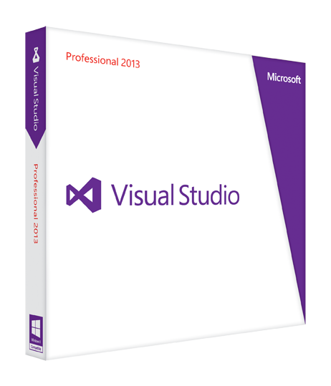


Code at the speed of thought.
Discover more great tools from Microsoft for students!

Slide 71


Use your Azure skills to enter Imagine Cup!
Notes:
Visit www.imaginecup.ca to see the deadlines and prizing for Imagine Cup 2015
Imagine Cup has three categories
Innovation – come up with a new and innovative idea using technology that has business potential
Games – Build a cool game!
World Citizenship – build an application that will help others
Your solution must use Visual Studio and one of the following platforms: Windows, Windows Phone, Azure
Deadline to submit your project is April 4th, 2015
If you have the time and an internet connection here is a cool video summary of the world finals https://sec.ch9.ms/ch9/0b68/88be7430-8566-4e2e-809b-373c3ea20b68/PostAwardCeremonyWrapUp_mid.mp4

Slide 72




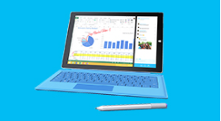


fff
#DevMov
Your skills. Our tools.
Earn Awesome rewards.
Major Challenges
App Challenges
Earn points for submitting apps.
Earn additional points for meeting the app challenge criteria:
Theme
Technical Feature
Promotion
Quality
Platform
Earn 1000 – 2000 points per major challenge.
Mini Challenges
Based around five types of activities:
Azure
Visual Studio
Visual Studio Online
Labs
MVA Courses
Example: Create a website and host it on Azure.
Earn anywhere from 100 – 500 points each.
Be more.
Do more.
…and more!
DeveloperMovement.ca
Notes:
Back by popular demand, Canada is bringing back the Developer Movement! The developer incentive program that rewards developers for learning about development and applying their skills!
Last year students and developers across Canada earned all sorts of prizes: t-shirts, $100 gift cards at the Microsoft store, Xbox One, even laptops!
You can sign up at www.developermovement.ca to start earning points!

Slide 73
Be first to know about
Student programs and tools!
like us on Facebook
fb.com/MicrosoftStudent
Notes:
When Imagine Cup is launched, or we announce this year’s Developer Movement in Canada, the first place we will talk about it is on our student Facebook page!
So Like our page and you can be among the first to know what’s happening for students in Canada!

Slide 74

Time for the evaluation
<Evaluation URL Here>

Slide 75
Now it's your turn to try it. Pick your lab!
Never coded before?
Try WordPress on Azure (Windows or Mac users)
Done some HTML/CSS?
Try the ftp and HTML lab (Windows or Mac users)
Love Visual Studio already?
Try the ASP.NET lab (Windows users)
Do you use Git? Node.js?
Try the NodeJS with Git lab (Windows version or Mac version)
aka.ms/StudentAzureHOL

Slide 76

© 2013 Microsoft Corporation. All rights reserved. Microsoft, Windows, and other product names are or may be registered trademarks and/or trademarks in the U.S. and/or other countries.
The information herein is for informational purposes only and represents the current view of Microsoft Corporation as of the date of this presentation. Because Microsoft must respond to changing market conditions, it should not be interpreted to be a commitment on the part of Microsoft, and Microsoft cannot guarantee the accuracy of any information provided after the date of this presentation.
MICROSOFT MAKES NO WARRANTIES, EXPRESS, IMPLIED OR STATUTORY, AS TO THE INFORMATION IN THIS PRESENTATION.

Slide 77
What Can the Cloud Do For Me?
<Name> | <Title>
<Contact Info>

